Slide 1
STATISTICS FOR DATA ANALYSIS
Vijayalaxmi Kaleguddi

Slide 2
What is the Statistics?
Statistics is applied Mathematics, Which deals with collection, organization, analyzing, interpretation and presentation of data.
Type of Statistics
the study of statistics has two major branches-
Descriptive Statistics: Is the branch of Statistics that involves the Organization, summarization , and display of data
Inferential Statistics: Is the branch of Statistics that involves using a sample to draw a conclusion about populations.

Slide 3
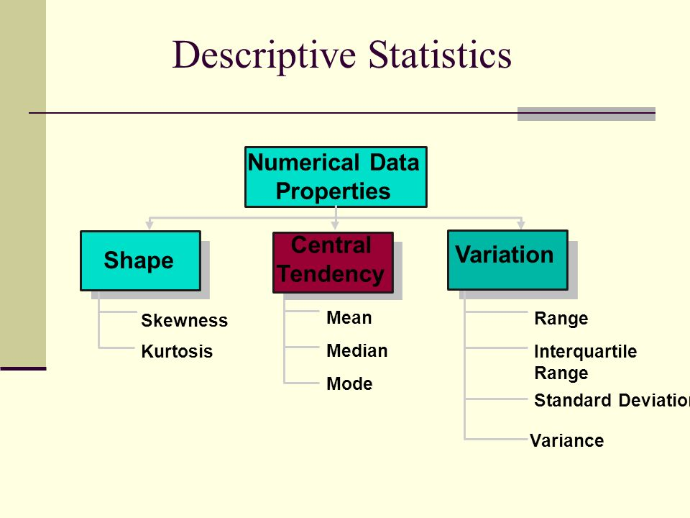

Slide 4
Data for Descriptive Statistics
Starting Balance | Interest Paid | Principal Paid | car_type
0 | 34689.96 | 202.93 | 484.30 | Toyota Sienna
1 | 34205.66 | 200.10 | 487.13 | Toyota Sienna
2 | 33718.53 | 197.25 | 489.98 | Toyota Sienna
3 | 33228.55 | 194.38 | 492.85 | Toyota Sienna
4 | 32735.70 | 191.50 | 495.73 | Toyota Sienna
... | ... | ... | ... | ...
403 | 3951.11 | 9.54 | 786.47 | VW Golf R
404 | 3164.64 | 7.64 | 788.37 | VW Golf R
405 | 2376.27 | 5.74 | 790.27 | VW Golf R
406 | 1586.00 | 3.83 | 792.18 | VW Golf R
407 | 793.82 | 1.91 | 794.10 | VW Golf R

Slide 5
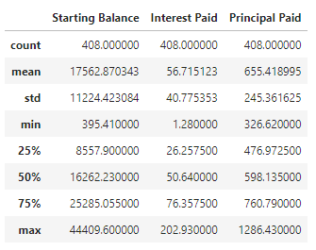
Descriptive Statistics | Starting Balance | Interest Paid | Principal Paid
Mean | 17562.87034 | 56.71512255 | 655.4189951
Standard Error | 555.6917469 | 2.018680771 | 12.14721052
Median | 16262.23 | 50.64 | 598.135
Mode | 21600 | 70.2 | #N/A
Standard Deviation | 11224.42308 | 40.77535283 | 245.3616253
Sample Variance | 125987673.6 | 1662.629399 | 60202.32715
Kurtosis | -0.616512042 | 1.766034833 | 0.381852575
Skewness | 0.493215089 | 1.219378847 | 0.991290394
Range | 44014.19 | 201.65 | 959.81
Minimum | 395.41 | 1.28 | 326.62
Maximum | 44409.6 | 202.93 | 1286.43
Sum | 7165651.1 | 23139.77 | 267410.95
Count | 408 | 408 | 408

Slide 6
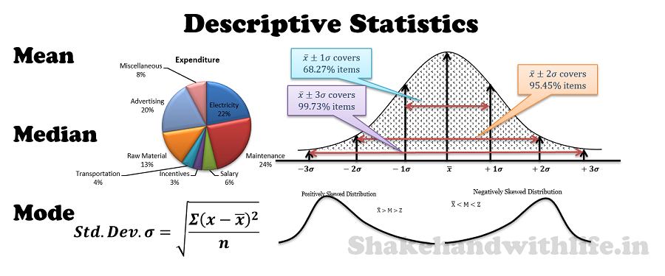

Slide 7
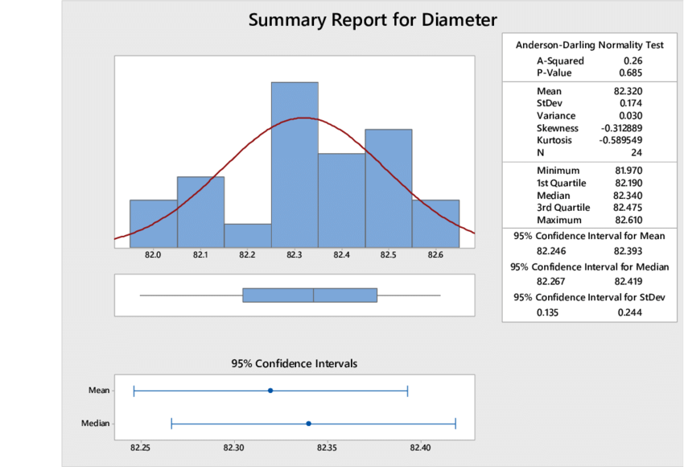

Slide 8
Why do we need Inferential Statistics?
Consider that we have to find the average salary of the data analyst
There are two options:
The first option is to consider the data of analyst across India and ask them their salaries and take an average.
The second option is to take a sample of data analyst from the major IT cities in India and take their average averages and consider for across India.

Slide 9
Why is inferential Statistics this important?
Making conclusion from a sample about population.
To conclude if a sample selected is statistically significant to or not.
Comparing two models to find which one is more statistically significant as compared to other.
In feature selection, whether adding or removing a variable helps in improving the models or not.

Slide 10
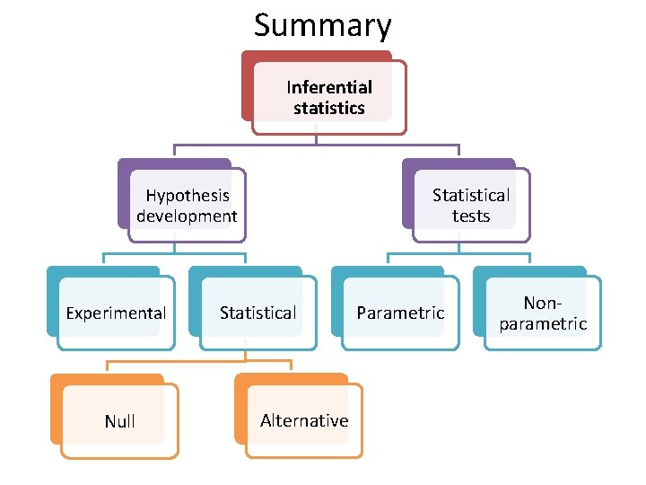

Slide 11
Hypothesis Testing
Hypothesis testing is a part of statistics in which we make assumption about the population parameter.
There is two type hypothesis
1)Null hypothesis
2)Alternative hypothesis

Slide 12


Slide 13
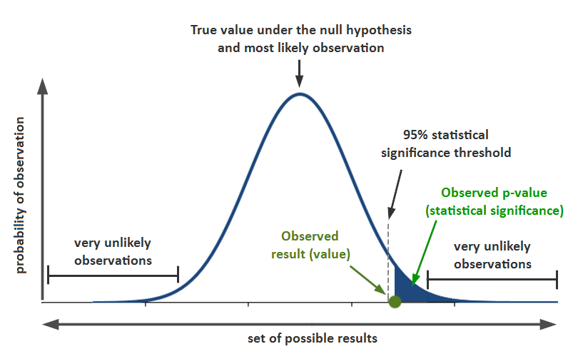
P-Value
Simple Definition:
Probability of null hypothesis to be true

Slide 14


Slide 15


